Slide 1
Dynamic Programming
Comp 122, Fall 2004

Slide 2
Longest Common Subsequence
Problem: Given 2 sequences, X = ⟨x₁,...,x_{m}⟩ and
Y = ⟨y₁,...,y_{n}⟩, find a common subsequence whose length is maximum.
springtime ncaa tournament basketball
printing north carolina krzyzewski
Subsequence need not be consecutive, but must be in order.
Comp 122, Spring 2004

Slide 3
Dynamic Programming
Dynamic Programming is an algorithm design technique for optimization problems: often minimizing or maximizing.
Like divide and conquer, DP solves problems by combining solutions to subproblems.
Unlike divide and conquer, subproblems are not independent.
  Subproblems may share subsubproblems,
  However, solution to one subproblem may not affect the solutions to other subproblems of the same problem. (More on this later.)
DP reduces computation by
  Solving subproblems in a bottom-up fashion.
  Storing solution to a subproblem the first time it is solved.
  Looking up the solution when subproblem is encountered again.
Key: determine structure of optimal solutions
Comp 122, Spring 2004

Slide 4
Steps in Dynamic Programming
Characterize structure of an optimal solution.
Define value of optimal solution recursively.
Compute optimal solution values either top-down with caching or bottom-up in a table.
Construct an optimal solution from computed values.
We’ll study these with the help of examples.
Comp 122, Spring 2004

Slide 5
Longest Common Subsequence
Problem: Given 2 sequences, X = ⟨x₁,...,x_{m}⟩ and
Y = ⟨y₁,...,y_{n}⟩, find a common subsequence whose length is maximum.
springtime ncaa tournament basketball
printing north carolina snoeyink
Subsequence need not be consecutive, but must be in order.
Comp 122, Spring 2004

Slide 6
Naïve Algorithm
For every subsequence of X, check whether it’s a subsequence of Y .
Time: Θ(n2^{m}).
  2^{m} subsequences of X to check.
  Each subsequence takes Θ(n) time to check:
  scan Y for first letter, for second, and so on.
Comp 122, Spring 2004

Slide 7
Optimal Substructure
Theorem
Let Z = ⟨z₁, . . . , z_{k}⟩ be any LCS of X and Y .
1. If x_{m} = y_{n}, then z_{k} = x_{m} = y_{n} and Z_{k-1} is an LCS of X_{m-1} and Y_{n-1}.
2. If x_{m} ≠ y_{n}, then either z_{k} ≠ x_{m} and Z is an LCS of X_{m-1} and Y .
3. or z_{k} ≠ y_{n} and Z is an LCS of X and Y_{n-1}.
Notation:
prefix X_{i} = ⟨x₁,...,x_{i}⟩ is the first i letters of X.
This says what any longest common subsequence must look like;
do you believe it?
Comp 122, Spring 2004

Slide 8
Optimal Substructure
Theorem
Let Z = ⟨z₁, . . . , z_{k}⟩ be any LCS of X and Y .
1. If x_{m} = y_{n}, then z_{k} = x_{m} = y_{n} and Z_{k-1} is an LCS of X_{m-1} and Y_{n-1}.
2. If x_{m} ≠ y_{n}, then either z_{k} ≠ x_{m} and Z is an LCS of X_{m-1} and Y .
3. or z_{k} ≠ y_{n} and Z is an LCS of X and Y_{n-1}.
Proof: (case 1: x_{m} = y_{n})
Any sequence Z’ that does not end in x_{m} = y_{n} can be made longer by adding x_{m} = y_{n} to the end. Therefore,
longest common subsequence (LCS) Z must end in x_{m} = y_{n}.
Z_{k-1} is a common subsequence of X_{m-1} and Y_{n-1}, and
there is no longer CS of X_{m-1} and Y_{n-1}, or Z would not be an LCS.
Comp 122, Spring 2004

Slide 9
Optimal Substructure
Theorem
Let Z = ⟨z₁, . . . , z_{k}⟩ be any LCS of X and Y .
1. If x_{m} = y_{n}, then z_{k} = x_{m} = y_{n} and Z_{k-1} is an LCS of X_{m-1} and Y_{n-1}.
2. If x_{m} ≠ y_{n}, then either z_{k} ≠ x_{m} and Z is an LCS of X_{m-1} and Y .
3. or z_{k} ≠ y_{n} and Z is an LCS of X and Y_{n-1}.
Proof: (case 2: x_{m} ≠ y_{n}, and z_{k} ≠ x_{m})
Since Z does not end in x_{m},
Z is a common subsequence of X_{m-1} and Y, and
there is no longer CS of X_{m-1} and Y, or Z would not be an LCS.
Comp 122, Spring 2004

Slide 10
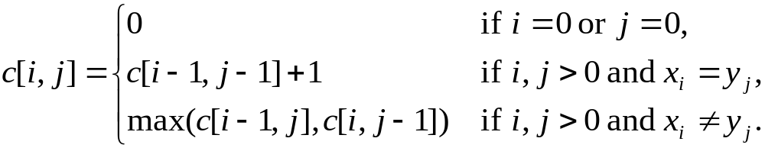
Recursive Solution
Define c[i, j] = length of LCS of X_{i} and Y_{j} .
We want c[m,n].
This gives a recursive algorithm and solves the problem.
But does it solve it well?
Comp 122, Spring 2004

Slide 11
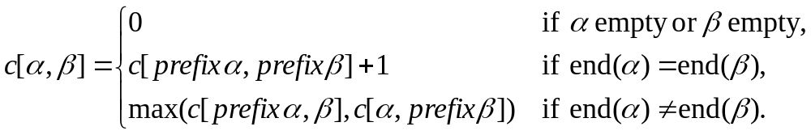
Recursive Solution
c[springtime, printing]
c[springtim, printing] c[springtime, printin]
[springti, printing] [springtim, printin] [springtim, printin] [springtime, printi]
[springt, printing] [springti, printin] [springtim, printi] [springtime, print]
Comp 122, Spring 2004

Slide 12
Recursive Solution
 |  | p | r | i | n | t | i | n | g
s
p
r
i
n
g
t
i
m
e
Keep track of c[α,β] in a table of nm entries:
  top/down
  bottom/up
Comp 122, Spring 2004

Slide 13
Computing the length of an LCS
LCS-LENGTH (X, Y)
m ← length[X]
n ← length[Y]
for i ← 1 to m
do c[i, 0] ← 0
for j ← 0 to n
do c[0, j ] ← 0
for i ← 1 to m
do for j ← 1 to n
do if x_{i} = y_{j}
then c[i, j ] ← c[i−1, j−1] + 1
b[i, j ] ← “ ”
else if c[i−1, j ] ≥ c[i, j−1]
then c[i, j ] ← c[i− 1, j ]
b[i, j ] ← “↑”
else c[i, j ] ← c[i, j−1]
b[i, j ] ← “←”
return c and b
b[i, j ] points to table entry whose subproblem we used in solving LCS of X_{i}
and Y_{j}.
c[m,n] contains the length of an LCS of X and Y.
Time: O(mn)
Comp 122, Spring 2004

Slide 14
Constructing an LCS
PRINT-LCS (b, X, i, j)
if i = 0 or j = 0
then return
if b[i, j ] = “ ”
then PRINT-LCS(b, X, i−1, j−1)
print x_{i}
elseif b[i, j ] = “↑”
then PRINT-LCS(b, X, i−1, j)
else PRINT-LCS(b, X, i, j−1)
Initial call is PRINT-LCS (b, X,m, n).
When b[i, j ] = , we have extended LCS by one character. So LCS = entries with in them.
Time: O(m+n)
Comp 122, Spring 2004

Slide 15
Steps in Dynamic Programming
Characterize structure of an optimal solution.
Define value of optimal solution recursively.
Compute optimal solution values either top-down with caching or bottom-up in a table.
Construct an optimal solution from computed values.
We’ll study these with the help of examples.
Comp 122, Spring 2004

Slide 16
Optimal Binary Search Trees
Problem
  Given sequence K = k₁ < k₂ <··· < k_{n} of n sorted keys,
  with a search probability p_{i} for each key k_{i}.
  Want to build a binary search tree (BST)
  with minimum expected search cost.
  Actual cost = # of items examined.
  For key k_{i}, cost = depth_{T}(k_{i})+1, where depth_{T}(k_{i}) = depth of k_{i} in BST T .
Comp 122, Spring 2004

Slide 17
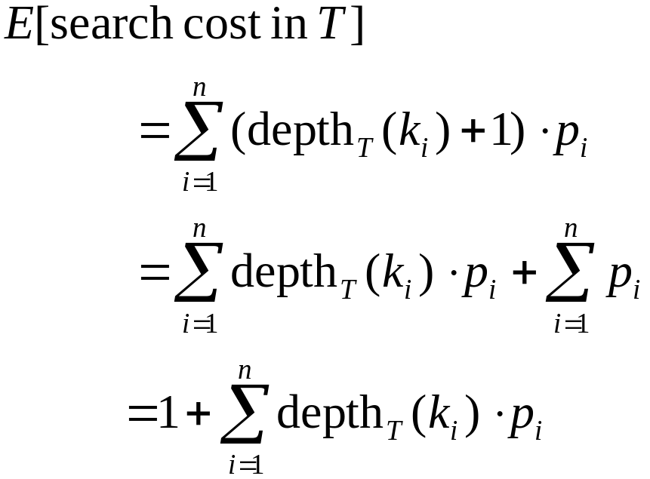
Expected Search Cost
Sum of probabilities is 1.
(15.16)
Comp 122, Spring 2004

Slide 18
Example
Consider 5 keys with these search probabilities:
p₁ = 0.25, p₂ = 0.2, p₃ = 0.05, p₄ = 0.2, p₅ = 0.3.
k₂
i depth_{T}(k_{i}) depth_{T}(k_{i})·p_{i}
1 1 0.25
2 0 0
3 2 0.1
4 1 0.2
5 2 0.6
1.15
k₁
k₄
k₃
k₅
Therefore, E[search cost] = 2.15.
Comp 122, Spring 2004

Slide 19
Example
p₁ = 0.25, p₂ = 0.2, p₃ = 0.05, p₄ = 0.2, p₅ = 0.3.
k₂
i depth_{T}(k_{i}) depth_{T}(k_{i})·p_{i}
1 1 0.25
2 0 0
3 3 0.15
4 2 0.4
5 1 0.3
1.10
k₁
k₅
k₄
Therefore, E[search cost] = 2.10.
k₃
This tree turns out to be optimal for this set of keys.
Comp 122, Spring 2004

Slide 20
Example
Observations:
  Optimal BST may not have smallest height.
  Optimal BST may not have highest-probability key at root.
Build by exhaustive checking?
  Construct each n-node BST.
  For each,
  assign keys and compute expected search cost.
  But there are Ω(4^{n}/n^{3/2}) different BSTs with n nodes.
Comp 122, Spring 2004

Slide 21
Optimal Substructure
Any subtree of a BST contains keys in a contiguous range k_{i}, ..., k_{j} for some 1 ≤ i ≤ j ≤ n.
If T is an optimal BST and
T contains subtree T′ with keys k_{i}, ... ,k_{j} ,
then T′ must be an optimal BST for keys k_{i}, ..., k_{j}.
Proof: Cut and paste.
T
T′
Comp 122, Spring 2004

Slide 22
Optimal Substructure
One of the keys in k_{i}, …,k_{j}, say k_{r}, where i ≤ r ≤ j,
must be the root of an optimal subtree for these keys.
Left subtree of k_{r} contains k_{i},...,k_{r−1}.
Right subtree of k_{r} contains k_{r}+1, ...,k_{j}.
To find an optimal BST:
  Examine all candidate roots k_{r} , for i ≤ r ≤ j
  Determine all optimal BSTs containing k_{i},...,k_{r−1} and containing k_{r+1},...,k_{j}
k_{r}
k_{i}
k_{r-1}
k_{r+1}
k_{j}
Comp 122, Spring 2004

Slide 23
Recursive Solution
Find optimal BST for k_{i},...,k_{j}, where i ≥ 1, j ≤ n, j ≥ i−1. When j = i−1, the tree is empty.
Define e[i, j ] = expected search cost of optimal BST for k_{i},...,k_{j}.
If j = i−1, then e[i, j ] = 0.
If j ≥ i,
  Select a root k_{r}, for some i ≤ r ≤ j .
  Recursively make an optimal BSTs
    for k_{i},..,k_{r−1} as the left subtree, and
    for k_{r+1},..,k_{j} as the right subtree.
Comp 122, Spring 2004

Slide 24
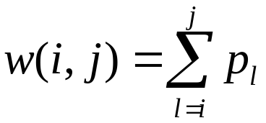
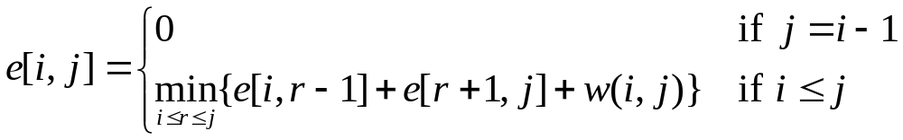
Recursive Solution
When the OPT subtree becomes a subtree of a node:
  Depth of every node in OPT subtree goes up by 1.
  Expected search cost increases by
If k_{r} is the root of an optimal BST for k_{i},..,k_{j} :
  e[i, j ] = p_{r} + (e[i, r−1] + w(i, r−1))+(e[r+1, j] + w(r+1, j))
  = e[i, r−1] + e[r+1, j] + w(i, j).
But, we don’t know k_{r}. Hence,
from (15.16)
(because w(i, j)=w(i,r−1) + p_{r} + w(r + 1, j))
Comp 122, Spring 2004

Slide 25
Computing an Optimal Solution
For each subproblem (i,j), store:
expected search cost in a table e[1 ..n+1 , 0 ..n]
  Will use only entries e[i, j ], where j ≥ i−1.
root[i, j ] = root of subtree with keys k_{i},..,k_{j}, for 1 ≤ i ≤ j ≤ n.
w[1..n+1, 0..n] = sum of probabilities
  w[i, i−1] = 0 for 1 ≤ i ≤ n.
  w[i, j ] = w[i, j-1] + p_{j} for 1 ≤ i ≤ j ≤ n.
Comp 122, Spring 2004

Slide 26
Pseudo-code
OPTIMAL-BST(p, q, n)
for i ← 1 to n + 1
do e[i, i− 1] ← 0
w[i, i− 1] ← 0
for l ← 1 to n
do for i ← 1 to n−l + 1
do j ←i + l−1
e[i, j ]←∞
w[i, j ] ← w[i, j−1] + p_{j}
for r ←i to j
do t ← e[i, r−1] + e[r + 1, j ] + w[i, j ]
if t < e[i, j ]
then e[i, j ] ← t
root[i, j ] ←r
return e and root
Consider all trees with l keys.
Fix the first key.
Fix the last key
Determine the root
of the optimal
(sub)tree
Time: O(n³)
Comp 122, Spring 2004

Slide 27
Elements of Dynamic Programming
Optimal substructure
Overlapping subproblems
Comp 122, Spring 2004

Slide 28
Optimal Substructure
Show that a solution to a problem consists of making a choice, which leaves one or more subproblems to solve.
Suppose that you are given this last choice that leads to an optimal solution.
Given this choice, determine which subproblems arise and how to characterize the resulting space of subproblems.
Show that the solutions to the subproblems used within the optimal solution must themselves be optimal. Usually use cut-and-paste.
Need to ensure that a wide enough range of choices and subproblems are considered.
Comp 122, Spring 2004

Slide 29
Optimal Substructure
Optimal substructure varies across problem domains:
  1. How many subproblems are used in an optimal solution.
  2. How many choices in determining which subproblem(s) to use.
Informally, running time depends on (# of subproblems overall) × (# of choices).
How many subproblems and choices do the examples considered contain?
Dynamic programming uses optimal substructure bottom up.
  First find optimal solutions to subproblems.
  Then choose which to use in optimal solution to the problem.
Comp 122, Spring 2004

Slide 30
Optimal Substucture
Does optimal substructure apply to all optimization problems? No.
Applies to determining the shortest path but NOT the longest simple path of an unweighted directed graph.
Why?
  Shortest path has independent subproblems.
  Solution to one subproblem does not affect solution to another subproblem of the same problem.
  Subproblems are not independent in longest simple path.
    Solution to one subproblem affects the solutions to other subproblems.
  Example:
Comp 122, Spring 2004

Slide 31
Overlapping Subproblems
The space of subproblems must be “small”.
The total number of distinct subproblems is a polynomial in the input size.
  A recursive algorithm is exponential because it solves the same problems repeatedly.
  If divide-and-conquer is applicable, then each problem solved will be brand new.
Comp 122, Spring 2004

